Slide 1


STS-1035
Welcome to Exploring Career Options
[STS-1035]
Notes:
Slides in this template are examples of the slides available in the Slide Master View. When creating a new Slide, use the same Master Layout as specified by the corresponding Sample Slide.

Slide 2

Diana McIntyre M.Ed. Professor

Slide 3
Appreciative Inquiry
What were you doing before coming to the GAS Program?
Why did you choose to enroll in the GAS Program?
What is your objective after finishing the GAS program?
Tell one thing that you would like to share about yourself that other people don’t know

Slide 4
Designing the Alliance
What do you need from your professor to make this a positive experience?
What specific behaviors do you require from your classmate to make this a positive and collaborative experience?

Slide 5
My Expectations
Respect: the culture of this classroom is inclusive – we seek to understand and not judge.
Ask: there is no such thing as a stupid question.
Participate: this course is about you – what you put into it is what you will get out of it.
Know: what you are expected to do each week including course pre-work and assignments.
Do: keep on top of your classwork and assignments.
Be: bring your best self to your coursework – commit to being authentic, curious, vulnerable and fearless.
Proactive Communication: if something is going on that is negatively impacting your course work…talk to your professor.

Slide 6
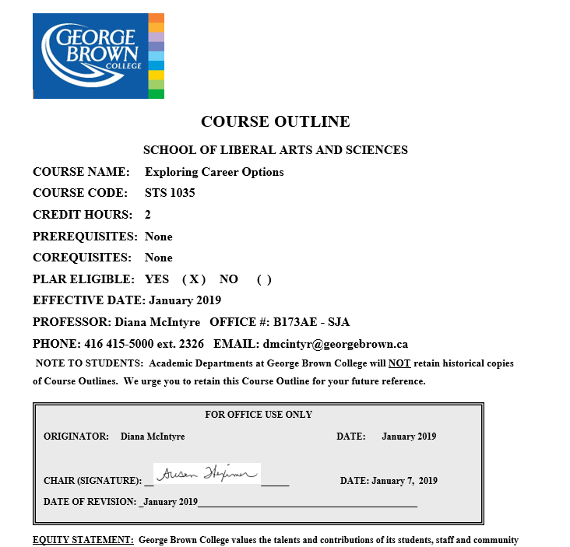
Course Outline for Exploring Career Options [STS-1035]

Slide 7
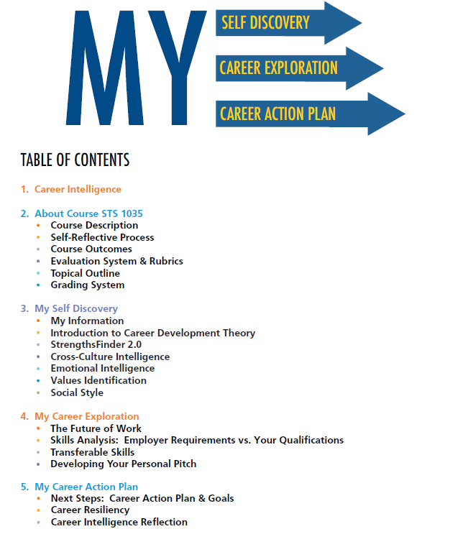
Career Intelligence Workbook

Slide 8
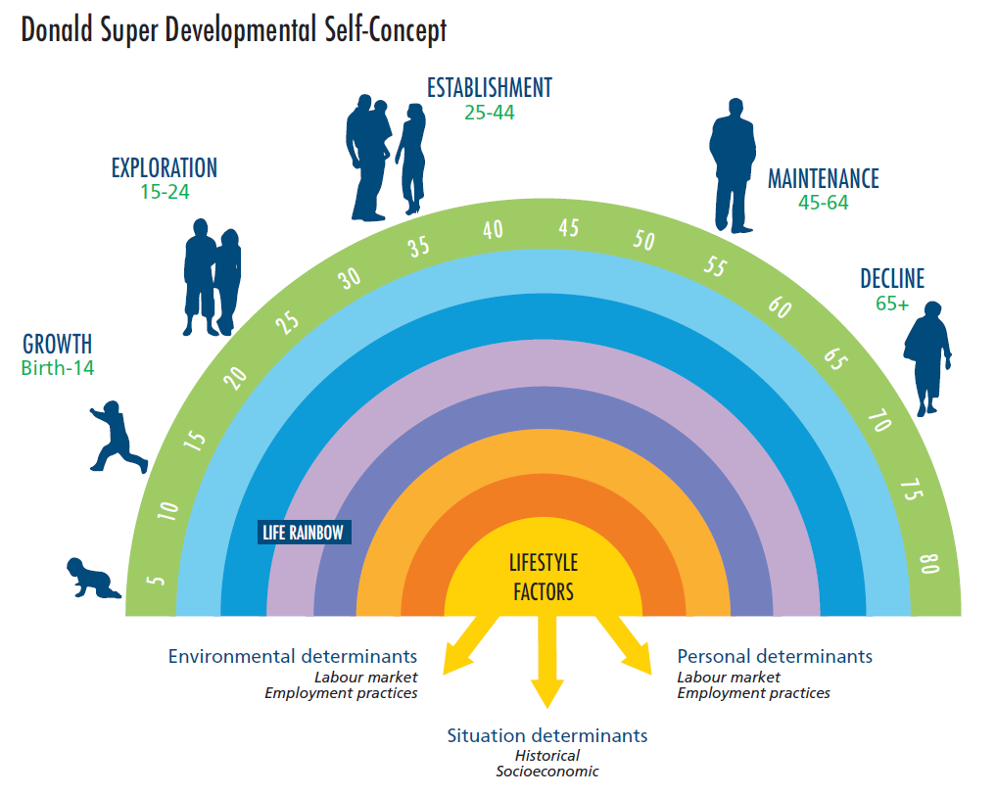
Career Development Theory
Career development can be compared to a road trip…sometimes you start down one road trying to get to your destination and you find there are detours and road closures that force you to take another route.

Slide 9
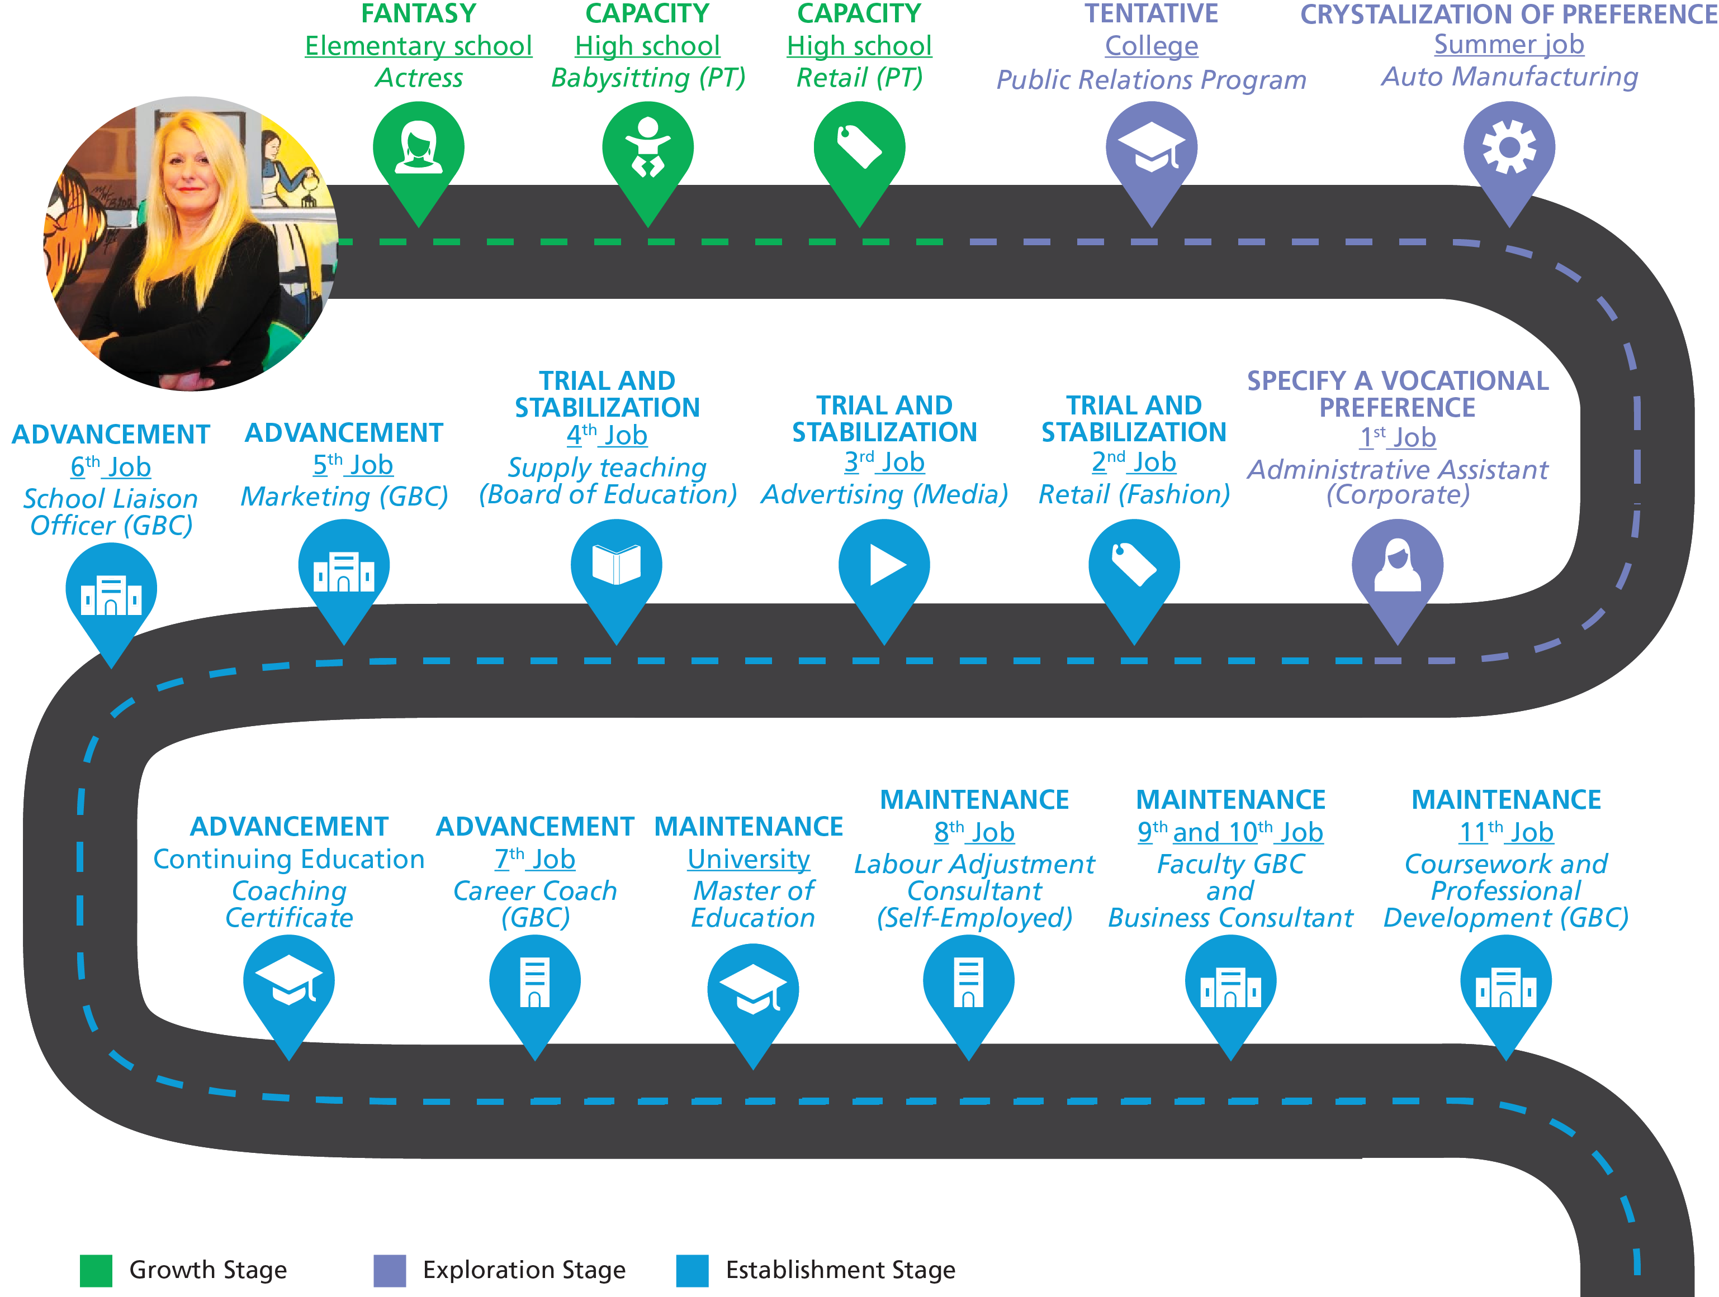
My Roadmap

Slide 10
Next Week
Complete the Gallup StrengthsFinder 2.0 Assessment using the code sent via e-mail
Watch Trombone Player Wanted (https://goo.gl/pgmzNz)
My Journey Assessment (Due Week 3)

